Slide 1




A GUIDE FOR INUIT WOMEN IN BUSINESS
FINDING AND ASSESSING
PROCUREMENT OPPORTUNITIES

Slide 2

Topics Covered
Researching Tender Opportunities
Where to look for tender opportunities
Procurement Portals
Canada Buys
Nunavut Tenders
Merx
Evaluating Contract Opportunities
Key Words

Slide 3
Common Terms
Tender: a formal invitation to participate in the procurement process by submitting a bid. Similar to RFP or RFQ.
Request for proposal (RFP): Used for complex requirements, containing both financial and technical criteria
Request for Quotations (RFQs): requesting suppliers to provide quotes for specific goods or services. RFQs are often used for more straightforward purchases, such as office supplies or equipment.
Bid: a proposal submitted by a supplier in response to a tender, RFP or other procurement opportunity

Slide 4
Common Terms (continued)
Solicitation: the process of requesting or seeking proposals, bids, or offers from suppliers or contractors to provide goods, services, or works for a project. Solicitation is part of the procurement process.
Contract: a legally binding agreement between a buyer and a supplier that outlines the terms and conditions of the procurement transaction.
Supplier: an individual or organization that provides goods, services, or works to a buyer.

Slide 5
Common Terms (continued)
Statements of Work (SOWs): a detailed description of the scope of work that the government requires the supplier to perform. The SOW outlines the specific tasks, objectives, deliverables, and timelines for the project.
Advance contract award notice: Used to inform businesses about a sole source, non-competed contract
Purchase order: a document used to authorize a procurement transaction and confirm the details of the purchase

Slide 6
Common Terms (continued)
Payment terms: the agreed-upon terms for payment between the buyer and supplier
Delivery date: the agreed-upon date for delivery of goods or services
Quality assurance: the process of ensuring that goods or services meet the specified quality standards
Compliance: adherence to legal, regulatory, and ethical standards in the procurement process.

Slide 7
Common Terms (continued)
Invitation to tender: Used commonly in real property and construction and awarded to the lowest bid
Letter of interest or request for information: Used to garner interest and gather information and feedback that may shape future requirements
Request for standing offer: Used to pre-qualify suppliers to provide goods and services when required, at firm prices
Request for supply arrangement: Used to pre-qualified suppliers to provide goods and services when required, at prices that are not fixed.

Slide 8
Researching Tender Opportunities
What is a tender?
What should you do?
An invitation for companies or individuals to submit proposals or bids to win a contract for a specific project or service.
Tenders are part of the procurement process, which ultimately can result in a contract.
Search by keyword in procurement/tender portals.
Look for a “Tenders” section on organizations’ websites that you are interested in working for.
Discover opportunities through social media or your network.
“When it comes to procurement itself…. It’s a lot of hunting and searching for RFPs.” — Inuit Woman Business Owner

Slide 9
Where to look for tender opportunities
Government portals: Check Canada Buys and GETS (Government Electronic Tendering Service). Here you can find opportunities for public contracts in Canada — this is a great resource for businesses looking to sell to government agencies. Tenders for all levels of government (federal, provincial, and municipal) can be found here.
Inuit Organizations: You can check with Inuit representative organizations across Inuit Nunangat and southern Canada for contracting opportunities. A list of links is provided at the end of this training package.
Private sector portals: There are many private sector portals that list procurement opportunities for businesses, such as MERX. Websites like these often have a pay-wall for full features. Through MERX, you can search for contracts in your region of Inuit Nunangat.

Slide 10
Where to look for procurement opportunities (continued)
Industry associations: Industry associations and trade groups often have resources for members to find procurement opportunities within their specific industry.
Not-for-Profit organizations: tenders for not-for-profits can be found on their own websites, on industry association sites, on private sector portals. You can call not-for-profits directly to inquire about opportunities or to offer your services.
Networking: Building relationships with potential buyers and suppliers can be a valuable way to find procurement opportunities. Attending trade shows, joining industry associations, and participating in business forums are all ways to connect with potential partners and learn about upcoming tenders.

Slide 11
Where to look for procurement opportunities (continued)
Social media: Social media platforms like Twitter and LinkedIn can be a useful source of procurement opportunities. Many government agencies and private companies use social media to promote their tender opportunities, so following these accounts can provide a stream of potential contracts.
Direct contact: Businesses can also reach out directly to potential buyers to express their interest in working together. This can involve sending a proposal or simply introducing the company and its capabilities.

Slide 12

Procurement Portals
A simplified way to search for tender opportunities

Slide 13
Canada Buys — Procurement Portal
What is Canada Buys?
The portal where you can find procurement opportunities with the federal government and other organizations such as provincial and municipal governments.
The government of Canada is streamlining their procurement processes to be all digital and run through the Canada Buys website.
The government of Canada also uses buyandsell.gc.ca and GETS (Government Electronic Tendering Service) but these are being phased out for Canada Buys.

Slide 14
Canada Buys — Procurement Portal
What should you do?
Familiarize yourself with the Canada Buys website
Search for tender opportunities for your area of business
Sign up for email notifications

Slide 15
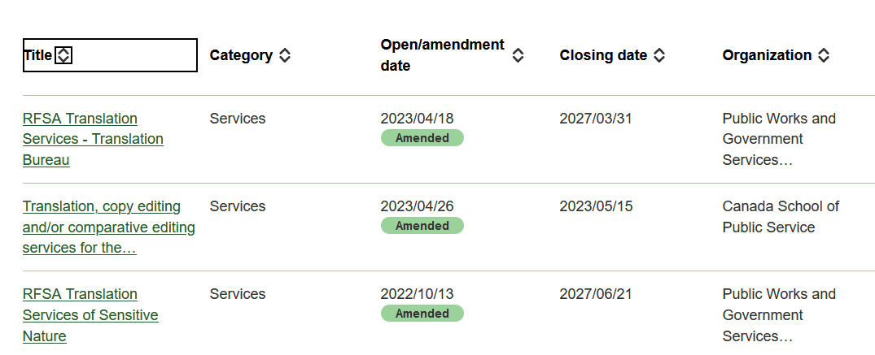
Navigating the Canada Buys Website
Example: results from the key word “translation”
We can see the tender titles, category (all “services” in this case), open and closing dates, and the organizations that the tenders are posted by.

Slide 16
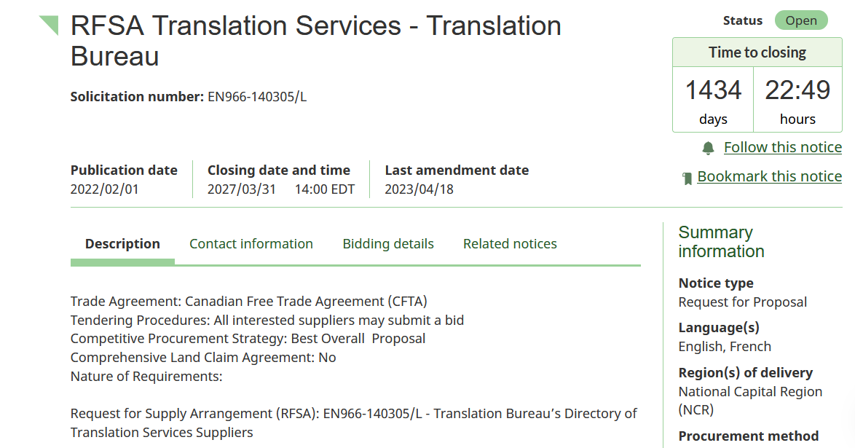
Navigating the Canada Buys Website
When the tender noticed is opened, we can see more information such as
a more detailed description
contact information (including a contact we can call with questions)
bidding details (including PDFs)
Related notices
Summary information tells us
Notice type
Language
Region
Procurement method (competitive)
Selection criteria

Slide 17
Canada Buys: Search by GSN
GSN: Goods and Services Number
Go to buyandsell.gc.ca → goods and services header → browse GSIN codes
Look for the title of your industry, click to open
Click on the number for the sub-industry you would like to explore, becoming progressively more specific

Slide 18
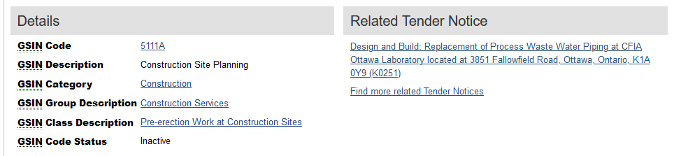
Canada Buys: Search by GSN
Related tender notices are listed on the right
In the example below, construction is 51, and we ended at 5111A for Construction Site Planning

Slide 19
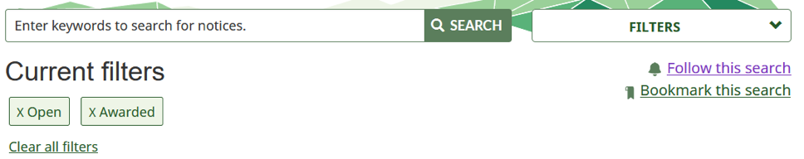
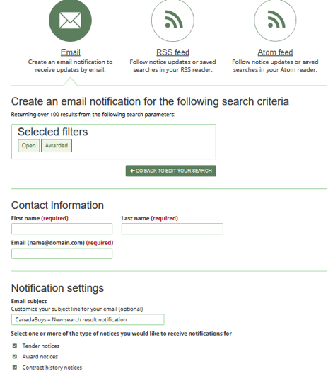
Canada Buys Email Notifications
On Canada Buys, create a search using your preferred key words and/or filters
On the right-hand side, click “follow this search”
From the next page, select your notification preferences and sign up

Slide 20
Nunavut Tenders — Procurement Portal
What is Nunavut Tenders?
What should you do?
The portal where you can find tender opportunities specific to the Nunavut region
The available opportunities are listed right on the main page
Your business must be registered with the website to open RFTs/RFPs
Familiarize yourself with the Nunavut Tenders website
Search for tender opportunities for your area of business in your browser using CTRL+F
Subscribe to Nunavut Tenders Listings

Slide 21
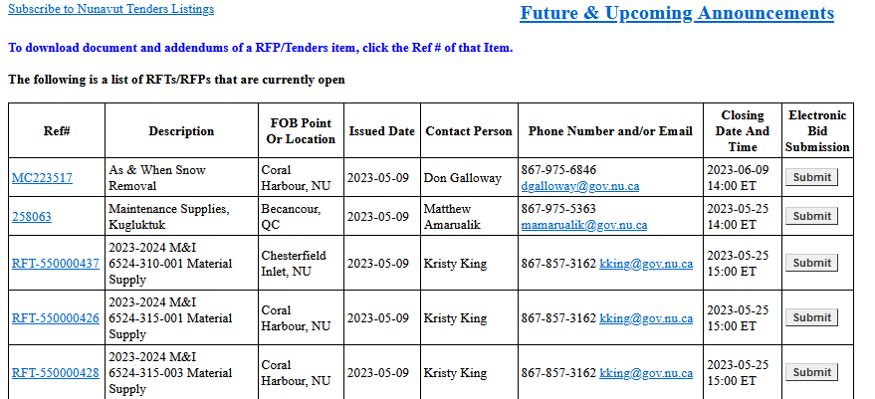
Navigating the Nunavut Tenders Website
Here we can see:
  Description
  Location
  Open and Closing dates
  Contact information
  Option to submit a bid
For more information, click on the reference # (you will need to register your business to do so)

Slide 22
Other Provincial and Territorial Sites
Other Provinces and Territories have their own procurement websites and portals, too. You may also find the same tender opportunities through Canada Buys or MERX
Contract Event Opportunities website of the Government of the Northwest Territories
SEAO (Quebec)
Newfoundland & Labrador’s Public Procurement Agency.

Slide 23
MERX — Procurement Portal
What is MERX?
MERX is a procurement portal that provides access to opportunities within:
  Provincial and municipal governments
  The MASH sector (Municipalities, Academic institutions, School boards, and Hospitals)
  The private sector
  U.S. federal, state and local opportunities
  Private construction service (houses, hotels, shopping malls, etc.)

Slide 24
MERX — Procurement Portal
What should you do?
Familiarize yourself with the MERX website
Search for tender opportunities by keyword
You must create a free account to view opportunities and there are fees for accessing additional services.

Slide 25
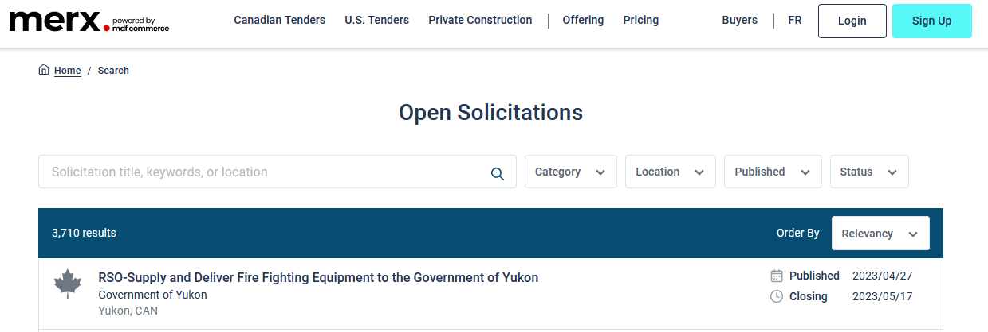
Navigating the MERX Website
Headings: Canadian Tenders, US Tenders, Private Construction
Search by Key Word
Filter by Category (industry), Location, Published date, Status (open, closed, etc.)

Slide 26

Evaluating Contract Opportunities
How to know if an opportunity is a good fit for your business.

Slide 27
Review the Documents
Carefully review the tender, request for proposal (RFP), request for quotation (RFQ), or other procurement documents to understand the: | Example: A Construction Project Opportunity
Scope of the opportunity: the range and extent of the goods, services, or works being solicited by the buyer. | The design and construction of a building, including site preparation, building materials, equipment, and labour.
Qualifications: the skills, experience, certifications, or other criteria a supplier must meet. | A valid construction license or certification A proven track record of success completing similar construction projects A minimum level of insurance coverage A demonstrated ability to manage a project of similar size and complexity Specific certifications or training required to meet the project requirements

Slide 28
Review the Documents (continued)
Carefully review the tender, request for proposal (RFP), request for quotation (RFQ), or other procurement documents to understand the: | Example: A Construction Project Opportunity
Evaluation criteria: the standards or benchmarks a buyer uses to assess and compare proposals or bids. | Technical capability Experience, Past performance Price Schedule and delivery Compliance

Slide 29
Assess Your Business’s Capabilities
Evaluate your company’s capabilities to determine if you have the capacity to meet the requirements outlined in the contracting opportunity, including:
Staff resources
Technical expertise
Financial resources
Equipment and Facilities
Assessing your business’s capabilities is an important step toward unlocking new growth opportunities. It’s a chance to evaluate where your business stands, identify areas for improvement, and strategically plan for future success.
Even if you don’t currently have all the necessary abilities to win a particular tender, this assessment process can help you develop a roadmap to get there and set your business up for long-term growth and success.

Slide 30
Identify Potential Risks
Identify potential risks associated with the contract opportunity, such as:
Project timelines: unforeseen delays, resource constraints, dependencies (one task can’t begin until another is completed), and mismanagement
Potential conflicts of interest: lost opportunities due to disqualification, legal actions or fines, damage to reputation
Legal and regulatory requirements: non-compliance (legal action, fines, penalties), time consuming to deal with, complex, and regulations may frequently change

Slide 31
Determine the Cost
Estimate the cost of delivering the products or services required by the contracting opportunity, including: | Example: A seamstress making seal skin mittens
Labour | 3 hours to make the mittens x $25/hr. = $75
Materials | Seal skin: $50 Thread/Other: $5 Total = $55
Overhead/Other | Rent, utilities, equipment, and other expenses. Monthly overhead costs: $500 Divided by 20 pairs of mittens per month $500/20 = $25.

Slide 32
Determine the Cost
Estimate the cost of delivering the products or services required by the contracting opportunity, including: | Example: A seamstress making seal skin mittens
Total Cost | Labour ($75) + Materials ($55) + Overhead ($25) = $155
Markup | Total cost: $155 Markup (30%): $46.50 Selling price: $201.50

Slide 33
Evaluate the Competition
Assess the competition to determine if there are other companies with similar capabilities and resources that may be competing for the same opportunity.
Understand the marketplace
Gain insights into the strengths and weaknesses of other suppliers
Understand pricing and quality expectations in the market
Identify market gaps that your business could potentially fill
Without competitors there would be no need for strategy.
—Kenichi Ohmae

Slide 34
Consider Partnering or Subcontracting
Determine if partnering or subcontracting with other companies or individuals may be necessary to fulfill the requirements of the contracting opportunity.
Subcontracting is when a supplier (the prime contractor) hires another company or individual (the subcontractor) to perform a portion of the work required for a particular contract or project.

Slide 35
Consider Partnering or Subcontracting
EXAMPLE:
A company that wins a government contract to provide IT services for a large government agency may not have all the expertise or resources in-house to fulfill the contract requirements. To address this, they can subcontract some of the work to another company specializing in database management. The prime contractor and subcontractor will negotiate a subcontract agreement outlining the scope of work, deliverables, timelines, and payment terms. The prime contractor will remain responsible for delivering the project to the government agency but they will rely on the subcontractor to provide a specific portion of the work.

Slide 36
Joint Ventures
A joint venture is a business arrangement where two or more companies or entities come together to form a new team to pursue a specific project or business opportunity. The companies involved in the joint venture will pool their resources, expertise, and capital to achieve a common goal.
In a joint venture, the companies involved typically share the profits and losses of the venture according to their percentage of ownership. The new entity created by the joint venture can be structured in different ways, such as a separate company, a partnership, or a limited liability company.

Slide 37
Joint Ventures
The greatest resource of a joint venture is neither the capital nor the technology involved, but the people who carry it out.
Joint ventures are often formed for large and complex projects that require significant financial resources, specialized knowledge, or technology.

Slide 38
Make a Bid/No-Bid Decision
Based on the information gathered by the prior steps, decide whether to pursue the contracting opportunity
TO BID:
start preparing your bid proposal, including developing a bid strategy, identifying your key strengths, and addressing any weaknesses or risks associated with your bid
NOT TO BID:
communicate your decision to the client and use the opportunity to learn from the experience and refine your bidding strategy for future opportunities
OR
That is the question…

Slide 39
Where Can I Get Help?
Pauktuutit has many resources available on our website:
Inuit Women in Business Network
Business Resources

Slide 40
Where Can I Get Help?
Region | Organization | Website
Inuvialuit | Inuvialuit Regional Corporation | https://www.irc.inuvialuit.com/
Nunavut | Nunavut Tunngavik Incorporated | https://www.tunngavik.com/tenders/
 | Kitikmeot Inuit Association | https://www.kitia.ca/
 | Kivalliq Inuit Association | https://www.kivalliqinuit.ca/careers-opportunities-2/
 | Qikiqtani Inuit Association | https://www.qia.ca/jobs-procurement/#procurement
Nunavik | Kativik Regional Government | https://www.krg.ca/en-CA/

Slide 41
Where Can I Get Help?
Region | Organization | Website
Nunatsiavut | Nunatsiavut Government | https://nunatsiavut.com/category/requests-for-proposals/
Southern Canada | Inuit Tapiriit Kanatami | https://www.itk.ca/opportunities/
 | Pauktuutit Inuit Women of Canada | https://pauktuutit.ca/tag/request-for-proposal/
 | Tungasuvvingat Inuit | https://tiontario.ca/news
 | Manitoba Inuit Association | https://www.manitobainuit.ca/

