Slide 1
A GUIDE FOR INUIT WOMEN IN BUSINESS
PROCUREMENT WITH THE GOVERNMENT OF CANADA

Slide 2
Topics Covered
The Benefits of Government Procurement
Procurement Strategy for Indigenous Businesses (PSIB)
Finding Opportunities
Building Networks
Low Dollar value procurement
Non-Competitive Procurement
Competitive Procurement
Procurement Phases
Digital Procurement
Supplier Registration
Benefits to Joining the Indigenous Business Directory
Next Steps & Resources

Slide 3
The Benefits of Government Procurement
Large and stable market
Supports smaller and diverse businesses
Rigorous and transparent process
Access to a wide range of procurement contract opportunities
Standardized payment terms to improve cashflow
Potential for long-term contracts
Reputation and credibility

Slide 4
Procurement Assistance Canada
This department supports smaller and diverse businesses through the federal procurement process
Engages, assists and informs businesses on how to sell goods and services to the Government of Canada
Works to reduce barriers to ensure fairness in the process
Looks for opportunities to advance supplier diversity through targeted outreach and advocacy

Slide 5
Opportunity for Smaller, diverse businesses
The Government of Canada is one of the largest buyers of goods and services in Canada
The GOC buys a wide range of goods and services each year, with contract values ranging from hundreds to billions of dollars
On average, smaller businesses in Canada win most of the total value of contracts awarded each year.
Small businesses are sought after for their ability to quickly solve problems and meet client needs

Slide 6
Procurement Opportunities with the Government of Canada
Public Services and Procurement Canada (PSPC) is the main procurement arm of the federal government
The Procurement Strategy for Indigenous Businesses (PSIB) is a federal government initiative designed to increase the participation of Indigenous businesses in federal procurement.

Slide 7
Procurement Strategy for Indigenous Businesses (PSIB)
The program was created to support Indigenous economic development and promote greater economic opportunities for Indigenous peoples across Canada.
Under the PSIB, Indigenous businesses are given preferential treatment in federal procurement processes.
The program requires federal departments and agencies to make a reasonable effort to identify and include Indigenous businesses in their procurement activities.
Set-aside opportunities for Indigenous businesses, this requires all government departments and agencies offer a minimum of 5% of the total value of their contracts to Indigenous businesses.

Slide 8
Procurement Strategy for Indigenous Businesses (PSIB) (continued)
The PSIB is based on the principle of "best value," which means federal departments and agencies will still consider factors such as price, quality, and delivery when evaluating bids from Indigenous businesses.
Other initiatives: providing training and support to Indigenous businesses and requiring prime contractors to include Indigenous subcontractors in their supply chains.

Slide 9
Finding Opportunities
Inuit Women have many unique skills that set them up to be successful in procurement, such as networking and relationship building, resourcefulness, and ambition.

Slide 10
Building Networks
For purchases under competitive procurement threshold levels, connect with officials in departments and agencies to learn about the direction their department’s procurement may be heading.
Connect with the PSPC contracting authority responsible for your particular good or service.
Promote your business, and share information regarding your capabilities and areas of delivery.

Slide 11
Low Dollar value procurement
Low Dollar contracts are below $25K for goods and below $40K for services
Most are awarded using a competitive process, but non-competitive approaches are used in some circumstances.
Sometimes contracts will be offered through networking, but this is challenging if there is an exhaustive list of potential clients
Suppliers may be identified through networks and research as well as various federal supplier registration systems.

Slide 12
Non-Competitive procurement
Sole source (non-competitive) purchasing can only be undertaken in the following four circumstances:
Pressing Emergency: delays could harm public interest.
Example: boats needed for an emergency evacuation
Cost not exceeding $25,000: not cost-effective to compete
Not in Public Interest
Example: national security
One Known Supplier
Examples: copyright, license or patent

Slide 13
Competitive procurement
Procurement over $25,000 for goods and $40,000 for services is done through the solicitation of bids and quotes from potential suppliers using a variety of methods.
The most common types are:
A Request for Proposal (RFP)
A Request for Standing Offer (RFSO)
A Request for Supply Arrangement (RFSA)
The contract notice will indicate the method of procurement being used and will outline the solicitation documents.

Slide 14
Procurement Phases
Contracts go through the following process from beginning to end.
Pre-contract phase:
when the planning happens before a contracting opportunity is posted
Defining what is needed and how to get it
Contracting phase:
the contract is bid on and awarded
Inviting bids (offers) from potential suppliers, evaluation of bids, selection of a winning bid, and providing feedback to unsuccessful bidders.

Slide 15
Procurement Phases (continued)
Contracts go through the following process from beginning to end.
Contract administration:
the contract is managed and monitored
Monitoring the progress of the contract, ensuring that deliveries are on schedule, making payments, monitoring optional periods or quantities, etc.
Post-contract phase:
the final actions and file closeout
The work is done, payments have been made, issues have been resolved, and contract requirements have all been met, etc.

Slide 16
Contracting Phase
The competition happens in step 2 (previous slide # 13) and follows these phases.
Contract
Notice Posted
Bids Submitted
Bids Evaluated
Winner Selected

Slide 17
Digital Procurement
The government of Canada is moving to “procurement” online — it’s becoming easier than ever to find and win contracts!

Slide 18
Government Electronic Tendering Service (GETS)
The official source suppliers should rely on to find Government of Canada contracts.
Suppliers (businesses) can use GETS to view and access bid solicitations and search for bid opportunities.
Easy to navigate and search for new contract opportunities as well as past contract awards.
Federal departments and agencies use GETS to advertise their requirements.

Slide 19
CanadaBuys.Canada.ca
Canada Buys is the source for government procurement information. The website is where federal government departments and agencies post their requirements online
Search for government contracts and contract history using plain language and filters.
Find data for any contracts, previous contracts, or current standing offers and supply arrangements.
Save your search and subscribe for updates by email or web feeds.
Register in the electronic procurement solution.

Slide 20
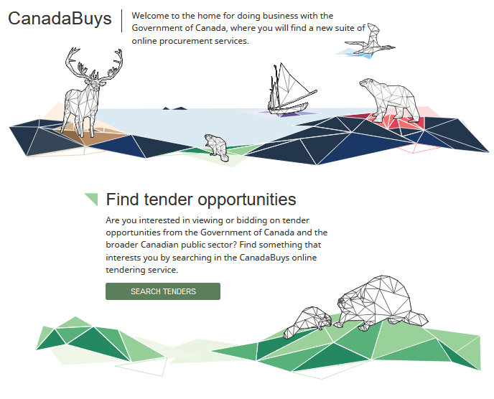

Slide 21
BuyAndSell.gc.ca
Your source for detailed procurement information, including:
How to register as a supplier
Procurement policies and guidelines
Key procurement contacts in departments and agencies
Procurement initiatives and programs
Upcoming events and seminars
Procurement applications
NOTE: Canada Buys is gradually replacing buyandsell.gc.ca In the meantime, detailed information is still on buyandsell.gc.ca

Slide 22
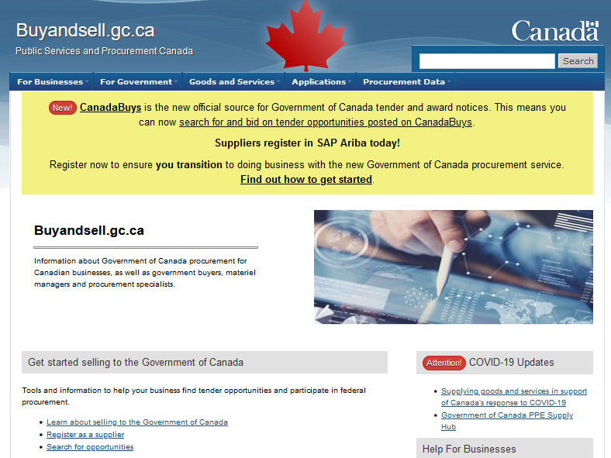

Slide 23
Supplier Registration
To participate in government procurement, you must register as a supplier.
First, register for a CRA Business Number. This will be asked for in other steps.
Register in Supplier Registration Information (SRI) to obtain your procurement business number. This number is currently required for bids that are not processed through SAP Ariba. SRI is the basic system for supplier registration.
Register in SAP Ariba to view and respond to opportunities posted to the electronic procurement solution. SAP Ariba is a more comprehensive platform for managing larger and more complex procurement projects. Find instructions here.

Slide 24
Supplier Registration
“There’s a lot to do to register as a business… we’ve spoken to our friends… people say it’s overwhelming. But you just need guidance and a checklist.”
— Inuit Woman Business Owner
Register in the Indigenous business directory. This will give your business a distinct advantage for competitive tenders.
Register in the Inuit Firm Registry through Nunavut Tunngavik Inc. (NTI)
Nunavut-based, 51%+ Inuit ownership only
* There are many other sub-categorical lists that you can register under depending on your business niche. For example: If your business offers a service, you can also register on the Supplier Registration Information (SRI) site or Centralized Professional Services System (CPSS)

Slide 25
Benefits to Joining the Indigenous Business Directory
INCREASED VISIBILITY: the directory is a public search engine available to private industry, municipal, provincial, and federal governments
FAST AND EASY registration process: 20 minutes to register, 2 days to be approved and published
PARTNERSHIP BUILDING: seek out opportunities to form partnerships and joint ventures
STAY INFORMED: upcoming Indigenous procurement events, networking opportunities and important procurement news
Supports the INDIGENOUS BUSINESS NETWORK in Canada: the more businesses registered demonstrating capacity, the more likely departments will set-aside contracts under Procurement Strategy for Indigenous Business (PSIB)

Slide 26
Learn more about procurement with the government of Canada
There are many resources available to help your business to find success!

Slide 27
Next Steps & Resources
Visit the Register as a supplier web page
Download reference sheets:
Getting started selling to the Government of Canada
Preparing to bid on an opportunity
Consult the service guide to see how Procurement Assistance Canada can help
Register for a seminar to help you understand the process and find opportunities

Slide 28
Next Steps & Resources
One-on-one meetings are available to provide more personalized support for your business. Contact someone today.
Infoline: call 1-888-247-4016 for questions related to procurement or the BuyAndSell.gc.ca website
There are many self-service tools with instructions and information to help you get started on buyandsell.gc.ca and CanadaBuys

Slide 29
Where Can I Get Help?
Pauktuutit has many resources available on our website:
Inuit Women in Business Network
Business Resources

