Slide 1
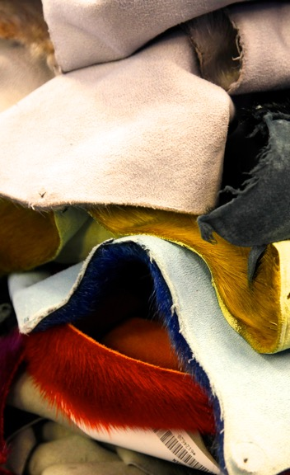
A GUIDE FOR INUIT WOMEN IN BUSINESS
REGISTERING AS AN INUIT BUSINESS

Slide 2
Topics Covered
Understanding Inuit Business Registration
Benefits of Joining the Inuit Firm Registry
Eligibility for the Inuit Firm Registry
Benefits of Joining the Indigenous Business Directory
Steps to Register as an Inuit Business
Supporting Documentation
Next Steps and Resources
Who can help?

Slide 3
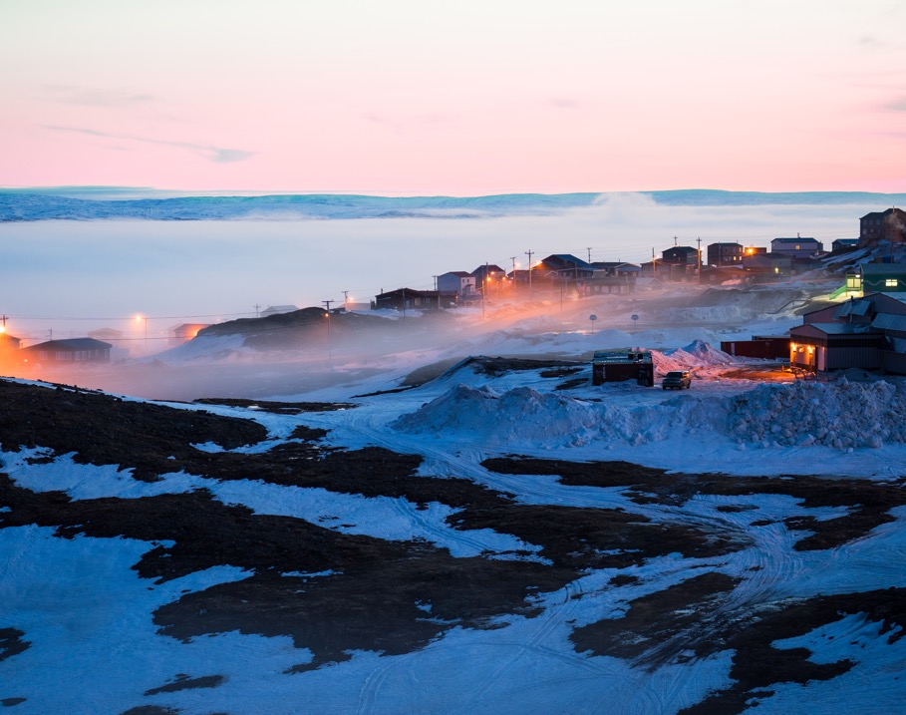
Registering as an Inuit Business
Registering as an Inuit business opens doors to various benefits and opportunities
Inuit women business owners have unique advantages and support available to them

Slide 4
Understanding Inuit Business Registration
Registering as an Inuit business showcases your Inuit heritage and business ownership
It establishes credibility and enhances opportunities for growth and success
There are two sites to register:
The Inuit Firm Registry—Nunavut Tunngavik Inc. (NTI)
The Indigenous Business Directory—Indigenous Services Canada (ISC)

Slide 5
Benefits of Joining the Inuit Firm Registry
ACCESS to government contracts: The Government of Canada and Government of Nunavut consult the Inuit Firm Registry when issuing contracts, increasing the chances of Inuit firms being considered for government projects and initiatives.
PREFERENTIAL BID ADJUSTMENT: ranging from 5% to 15%, which can give a competitive edge when bidding on government contracts.
VISIBILITY AND CREDIBILITY: demonstrates capacity to compete and participate in the Nunavut economy.

Slide 6
Benefits of Joining the Inuit Firm Registry
ELIGIBILITY for grants and financing: programs offered by organizations like Atuqtuarvik, Kivalliq Partners in Development, Kakivak Association, and the Kitikmeot Economic Development Commission.
MAXIMIZE OPPORTUNITIES for Inuit employment and business: employment, training, and business opportunities in land use licenses, leases, exploration agreements, and Inuit Impact and Benefit Agreements.
COLLABORATION AND PARTNERSHIPS: Being on the list facilitates collaboration and partnerships with other Inuit firms and organizations, opening doors to joint ventures and collective business opportunities.

Slide 7
Benefits of Joining the Inuit Firm Registry
SUPPORT AND RESOURCES: support, resources, and programs aimed at enhancing business development, capacity building, and networking.
REPRESENTATION AND EMPOWERMENT of Inuit businesses, contributing to the overall economic growth and prosperity of the Inuit community in Nunavut.
Compliance with Article 24 of the Nunavut Agreement: which aims to improve the participation of Inuit firms in the Nunavut economy and secure Inuit employment at representative levels.

Slide 8
Eligibility for the Inuit Firm Registry
Purpose: The Inuit Firm Registry is established to implement Article 24 of the Nunavut Agreement, overseen by the NTI Policy & Planning Division.
Definition of an Inuit Firm: An entity that complies with the legal requirements to conduct business in the Nunavut Settlement Area. It can be:
a limited company with at least 51% Inuit beneficial ownership
a cooperative controlled by Inuit
an Inuk sole proprietorship or partnership.

Slide 9
Eligibility for the Inuit Firm Registry
Classes of Inuit Ownership: The Inuit Firm Registry categorizes firms into three classes based on the percentage of Inuit ownership:
Class 1:51% to 75% Inuit Ownership
Class 2:76% to 99% Inuit Ownership
Class 3:100% Inuit Ownership

Slide 10
Steps to Register as an Inuit Business with NTI
STEP 1:
GATHER REQUIRED INFORMATION & CONTACT THE NTI POLICY & PLANNING DIVISION:
This may include business details, ownership information, legal documentation, and contact information. NTI will provide guidance on the registration requirements and procedures.
STEP 2
COMPLETE REGISTRATION FORMS:
Provided by the NTI policy & planning division. Provide detailed information about your business, including ownership structure, business activities, and any affiliations.

Slide 11
Steps to Register as an Inuit Business with NTI
STEP 3
SUBMIT REQUIRED DOCUMENTATION:
Such as copies of business licenses, NTI enrolment number, and other relevant legal documents.
STEP 4
REVIEW AND VERIFICATION:
The NTI policy & planning division will review your registration application and supporting documents. They may contact you for clarification or additional information if needed.

Slide 12
Steps to Register as an Inuit Business with NTI
STEP 5
REGISTRATION CONFIRMATION:
Once approved, you will receive a confirmation or certificate indicating your status as a registered Inuit business. Congratulations!

Slide 13
Supporting Documentation
The following documentation may be required for registration. The corresponding pages and forms are linked:
The application form for the Inuit Firm Registry with NTI
The application form for the Indigenous business directory with Indigenous Services Canada.
Proof of Inuit Heritage: an NTI Enrolment Card/Number

Slide 14
Supporting Documentation
Business Licenses with NNI or your local municipality
Declaration of Use of a Business Name with NTI
Other certifications and licenses, depending on your field of business

Slide 15
Next Steps & Resources
There is nothing to it but to get started! Pick one of these actions to take today:
Start the process to get registered: download the NTI form or visit the Indigenous Services Canada website and get started
Contact NTI or Indigenous Services Canada and ask for help
Visit the Pauktuutit website and check out the other resources available
Reach out to your local Economic Development Officer
Make a short list of things to do or collect to be able to register
Tip: when feeling overwhelmed, try to figure out
“What is the next right step?”

Slide 16
Benefits to Joining the Indigenous Business Directory
ACCESS: to Procurement Opportunities, Contracts, and Funding
INCREASED VISIBILITY: the directory is a public search engine available to private industry, municipal, provincial, and federal governments
FAST AND EASY registration process: 20 minutes to register, 2 days to be approved and published

Slide 17
Benefits to Joining the Indigenous Business Directory
PARTNERSHIP BUILDING opportunities: seek out opportunities to form partnerships and joint ventures
STAY INFORMED: upcoming Indigenous procurement events, networking opportunities and important procurement news
Supports the INDIGENOUS BUSINESS NETWORK in Canada: the more businesses registered demonstrating capacity, the more likely departments will set-aside contracts under Procurement Strategy for Indigenous Business (PSIB)

Slide 18
Eligibility for the Indigenous Business Directory
Ownership and Control:
At least 51% of the firm’s ownership and control must be held by Indigenous people.
If the firm employs six or more full-time staff, a minimum of one-third of the employees must be Indigenous.
Joint Ventures:
At least 51% of the joint venture must be owned and controlled by an Indigenous business or businesses.

Slide 19
Eligibility for the Indigenous Business Directory
Indigenous Content:
A firm seeking Indigenous business classification must demonstrate the following for the contract’s duration:
A level of Indigenous content equivalent to 33% of the value of the work performed by the Indigenous business.

Slide 20
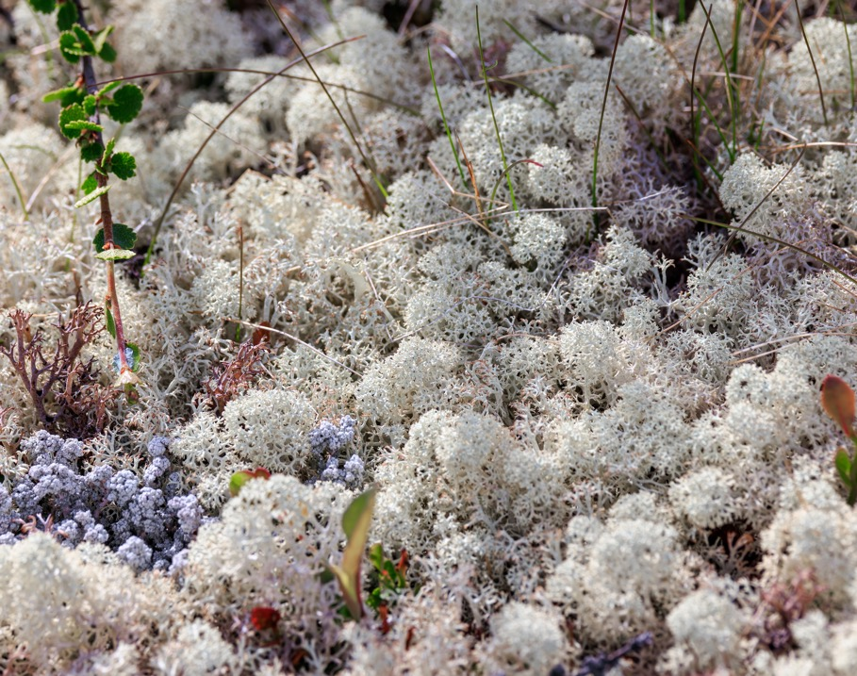
Speaking from Experience
“You meet NTI for a number, you need a pretty good history with your contracting bids, there are steps you have to explain when sending in your bid. You just do what you can on whatever they are asking, providing info.”
— Inuk Woman Business Owner

Slide 21
Summary
There are many advantages to registering as an Inuit-owned business, including having a competitive edge in the procurement process. You can register with NTI and the Government of Canada. All the forms and information are available online, and it’s a matter of going one step at a time to gather the necessary documents and complete the process. If you need help, Pauktuutit, NTI, Indigenous Services Canada, local Economic Development Officers, and more are available to assist the process.

Slide 22
Who can help?
There are many resources available across Canada for indigenous entrepreneurs. These are just a starting point:
Pauktuutit offers many resources supporting Inuit women in business, including:
Mentorship Programs
Training Workshops
Inuit Women in Business Network
Local Economic Development Officer: see your municipality’s website
Indigenous Services Canada programs and services

