Slide 1


MARKETING
Marketing for Inuit
Women Entrepreneurs
Inspiring Entrepreneurship for Stronger Inuit Communities

Slide 2

WHAT IS MARKETING?
Different things you can do to promote your products or services to potential clients and includes advertising, selling, and delivering.
Notes:
Warm up slide. Elicit responses here from group: off the top of their head, in the chat box or sharing in person: what do they think marketing is? What are some excellent ads that you’ve seen on TV, in the newspaper, online or locally that you really liked/captured your attention?
Ask: What is the goal of Marketing?
Share with Group:
Here is a really basic definition of marketing.
The difference between a product and a service: a product is an object or item that the person will walk away with, like a piece of clothing, food item; and a service is paid work you do to help them, like building a website, learning Inuktuk on a course, attending an educational camp, or give advice to the government on Northern/Inuit affairs;
Remember: Marketing is not the same for every business. Each business is unique and requires different strategies to reach your desired audience.
Ongoing Activity: encourage participants to take notes as go along, and give them time to write out first thoughts on each question or topic after having gone over each slide, where appropriate

Slide 3



MARKETING IS…
Know each of these and you have your Marketing Plan!
01
WHAT YOU SELL (IT’S VALUE, THE BRAND BEHIND IT
02
WHO YOU SELL TO (IDEAL CUSTOMER)
03
WHERE ARE YOU GOING TO MARKET?
04
HOW WILL YOU ADVERTISE?
05
DELIVERING YOUR PRODUCT/SERVICE
06
WHAT PRICE WILL YOU SET?
Notes:
Notes to Deliverer: Reference whatever definitions of marketing came out of first slide.
Say to group: Here is a more detailed idea of what Marketing is. As you can see, marketing is more than just advertising, promoting & selling. It requires a clear plan and process that you can follow to be successful. There are several parts and steps to marketing. This becomes your Marketing Plan. Your Marketing Plan is an important part of your Business Plan

Slide 4
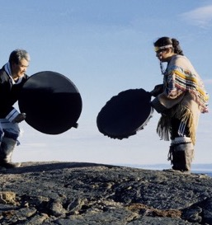
What You Sell
What are your values and beliefs (your brand, your story) behind your business?
What is the value of your product or service? (ie. what makes it special?)
What is the customer experiencing or getting from your service/product?
What’s your ultimate goal going into business selling this service/product?
Example: take a moment to look at how it all comes together for Hinaani Design.
www.hinaani.ca
Notes:
Say to Group: What you sell is not just the object or service, like jewellery or helping people build a website. It’s so much bigger than that! There is a story behind your business, your product, a reason for doing what you do. You have to see and believe in the value of what you make or do - see yourself in it. You have to be able to see your customer gaining something - satisfaction, happiness, from it.
Is your ultimate goal with selling your product or service just to make a few dollars on the side? Meet more people in the community? Help others? Gain personal satisfaction? Build a profitable business that can support you and your family? Knowing this helps you make decisions about how big you want to go, and thus how to market.
Activity: Give participants time to write out answers to questions on slide. If there is time, it is great for the group to share their business ‘story’, and their values behind their product/business/service: why do they believe in it?

Slide 5
Who are your ideal clients?
Can you describe your ideal client?
Do they truly need your service/product?
How do you know?
Are they already buying something similar elsewhere?
Notes:
Say to Group:
Once you have determined who you are marketing too, defining your messaging becomes easier. For a good example, see the profile of Sadie Vincent-Wolfe, owner of I Like Cake, on the Pauktuutit website: her clear target clients were more obviously families, probably more precisely mothers, needing cake to celebrate birthdays. Customers can buy southern, pre-made cakes at stores, but can’t really individualize. A further clientele opened up though as word of her products spread: government departments or offices needing cakes for formal celebrations. Now her messaging will have to change to include and expand on this larger market.
Taking into account the community values will also go a long way toward connecting with your potential customers. For example on the Pauktuutit website Profile, Bernice Clark from Oasau Soap started including local materials that her clientele valued as part of Inuit tradition, adding to her product line and bringing in more customers.
Activity: Give participants time to write out answers to questions on slide.

Slide 6

Where are you going to market?
Locally? Regionally?
Nationally? Internationally?
Activity: name a business you know that markets:
Locally only (i.e. only targets population ‘in town’ both promoting and selling product)?
Regionally in the North?
In Canada?
Internationally?
© Credit: Ilkka Koivula
Notes:
Say to group:
Do you want to start small, see how it goes and maybe expand? What makes most sense for you and your product/service?
Activity: explore with participants local examples in the North of those who market only locally (hamlet/town), regionally, etc.
Activity: have the participants note down where their markets would be for their product.

Slide 7

How will you advertise or promote?
Different ways:
Word of mouth
Referrals
Online social media (FB, Instagram)
Through your or other’s website (Amazon, Etsy, etc)
Door-to-door, etc.
IWBN has detailed resources on using FB and Etsy:
pauktuutit.ca/iwbn/resources/
using-facebook-and-etsy-for-business/
Notes:
Discussion: ask participants: what have you bought recently that you heard about from each of these different sources? Explore with them: Which are best suited to what type of markets?
Possible answers: word of mouth, door to door, referrals, and some social media good for local; your own website, Etsy and SM like FB, Instagram, best for North/international/national
Activity: go back over the examples from the last slide of products and services marketed locally, regionally, nationally etc. Which of these ways were used for each?
Say to Group: It is very important to keep up on promoting your product or service (through any of your chosen methods), even when there seems to be a lot of business coming in and it doesn’t seem necessary. This will mean a steady stream of future clients in case you lose some or there is a dry spell.

Slide 8

How to market to a small community
…where people often have a preferred supplier, contractor, or shop. What works best here?
Use word of mouth
Sponsor or join local events: run a contest, prize draws, set up a table at the local co-op
Get local paper or radio show coverage
Give away freebies
Be active online…e.g. FB: Baker Laker Community Events or Iqaluit Public Service Announcements
Online advertising
Train and educate your employees (if you have them) so they can also market for you
Notes:
Share with Group:
If you have no exact competitors, like Sadie Vincent-Wolfe with her I Like Cake service in Iqaluit, then marketing to your small community is easier. If you have competitors, you have to stand out. A good and personal customer service experience and connection with potential customers, and something that makes you different, is important to keep customers coming back. Work on Building a strong, positive reputation with the community.

Slide 9
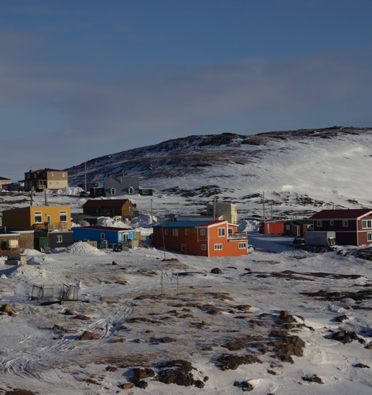
Online advertising in the North
Depending on community technology capacities, marketing online to a regional/Northern clientele may have unique benefits as well as challenges.
Connection reliability
People may not be able to rely on the internet/computer connection for information
More people on mobile devices: are your website and payment options set up to be mobile friendly?
Are you comfortable using mobile apps (FB, etc) as a way to ‘talk’ to potential customers?
Notes:
Discussion: what types of sites are the participants already on and comfortable with? What is their experience around connectivity in their community?
Share with Group: Google cares a lot if your website is mobile friendly and allows it to be seen more easily if it is - something to consider if using an online platform.

Slide 10
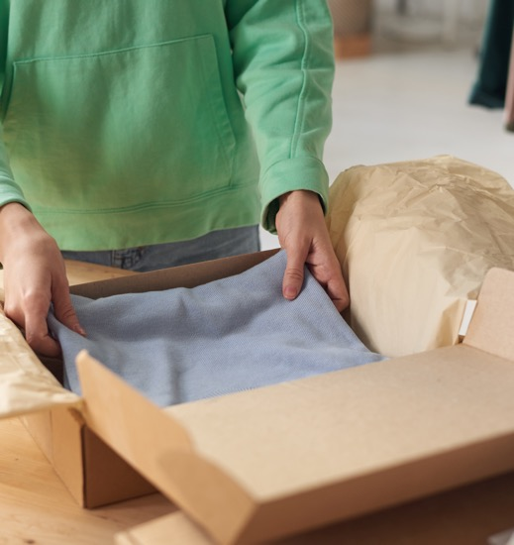
Selling & delivering your product or service
How can the customer order? On-line? By email? Phone?
How will they pay? By credit card, cash, interac, Square?
Will you deliver yourself? Send by mail? Package? Air? Boat?
Have people come pick up?
A great ‘Customer Service Experience’ = repeat customer!
Notes:
Share with Group: In the beginning of your business, when your customer base is still small, this might seem less important than the other parts of your business. But you have to think to the future, and make this part easy for you, as well as for an increasing number of customers.
Now that you have interested customers, how do you connect them with the product or service? Making this part easy is also part of the customer service experience you are giving your client (on top of making it easy to find you in the first place)
Activity: Give participants time to write out answers to questions on slide.

Slide 11
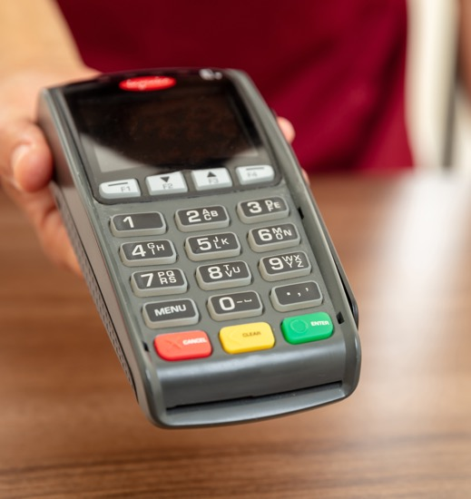
Pricing your product or service
How do I know what to charge?
Often, we undercharge.
You need to consider:
What are all the costs? Let’s come up with a list together.
Any profit (income after expenses) you would like to make per product or service.
What customers are willing to pay and how do we know this?
Notes:
Say to Group:
There’s a balance between over and undercharging, usually we undercharge.
Sometimes, we might decide to come in a little lower at the beginning with an introductory offer, to attract customers. You have to decide how long to offer a reduced price, and by how much. You should target an ultimate price that gives you a decent profit. If after your research and calculations a reasonable price doesn’t cover your costs or brings no profit, you have to re-visit your costs, and where you can cut, or even your whole business model (e.g.find a different way to ship)
Discussion: what are the different business costs? Come up with a list together with participants and have them write them down. List should include: a.materials (estimate per product item); b.shipping costs if any; c.your time (per hour to make or provide service: what is this worth?); d.costs to run business: (website cost, any software or app costs, accountant or bookkeeper, printing, business cards, advertising, e.energy (a rough estimate of electricity for machines, heat, etc, used while creating product, if done from your home); f. rent for store, if you have one, or portion of rent (if working from home: ask your accountant what this should be).

Slide 12

Example price calculation
First, research market (what similar product/service costs; ask potential customers what they would pay), then add costs/profits.
Example: a pair of custom-made sealskin mitts:
hard costs (materials, promotion, time;
portion of business costs) = $250
+
what you’d like to be making as profit = $100
Price = $350
Notes:
Share with Group: Often, entrepreneurs don’t consider the time they have to put in, especially when calculating the value or price of their product. In the beginning, you may have to ‘swallow’ this expense, but it must be part of your long term pricing and viability (= ability to stay open as a business).
In this example, you are able to get the main materials (seal and caribou skin) at a reasonable price or for free from family or local hunters, and accessories like beads, etc, you buy from a friend in another hamlet. Then you put in 3 days - soon you will get faster, down to 2 days. The total for your costs is $250 - maybe a little more as initially you spend more time.

Slide 13

Now it’s your turn
“What’s your product/service?
Now create your plan!”
Checklist:
What you sell (its value, the brand behind it)
Who you sell to (ideal customer)
Where are you going to market?
How will you advertise?
Delivering your product/service
What price will you set?
Notes:
Participants can use this template, and the guiding questions for each checklist item from the slides, to start filling out their Marketing Plan.

Slide 14
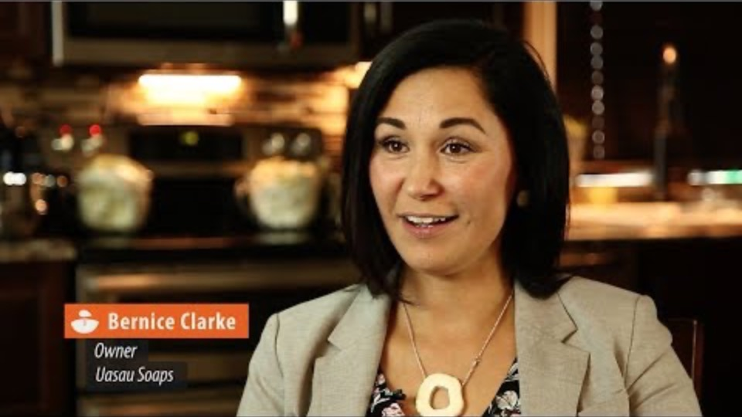
Final activity
Working in small groups of 2-3, imagine you are in charge of helping her market her Bowhead whale soap as a skin-care product that helps with eczema for children and adults. Bernice wants to get her products into a southern Canadian as well as Inuit in the Northern market.
Take 10 minutes to discuss it with your partner.
What are some methods Bernice can use to attract a wider market (both southern and northern) to buy her soaps?

Slide 15

Congratulations!
You’ve just learned the key parts of a marketing plan!
Now make it real:
Notes and Q&A
Take the time to write down any ideas, information or ask questions about any of what was covered in this workshop. Especially specific to your business idea.
Notes:
Say to Group. We’ve just been through a lot of different information. It’s your turn to take some more time to reflect, absorb, and ask questions. Anything the seems unclear still? Think in terms of your business idea.
Notes to Deliverer: This helps cover anything that got missed, and for participants to commit things to long-term memory

Slide 16

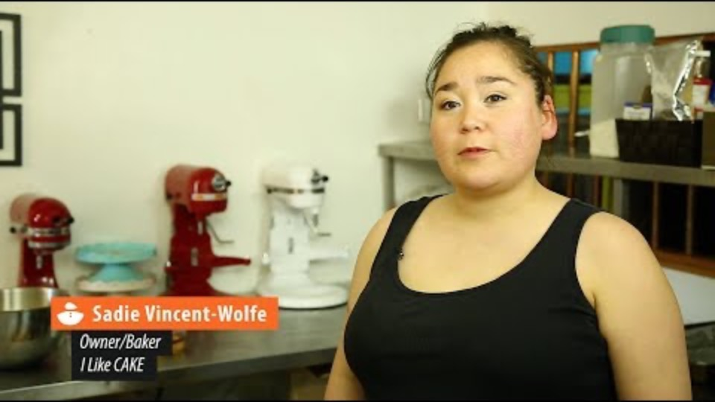
RESOURCES
Sample Marketing Plans
Marketing Through Facebook and Etsy
© Credit: Ilkka Koivula
Notes:
The IWBN and PAUKTUUTIT and other websites have a lot of great information: here are some links to help you access more detail on the different parts of your marketing plan. Start having conversations and talking to others about your business: a great thing to do while you’re setting up and putting your marketing plan into place.

Slide 17

Wrap up…
Share something that stood out for you, that you learned from this workshop, or that you would like to share with the group before leaving.
Is there something you are excited to start doing?
Notes:
Notes to Deliverer: This wrap up helps with closure and commitment to road ahead.

Slide 18

QUJANNAMIIK
THANK YOU!
Inspiring Entrepreneurship
for Stronger Inuit Communities
Notes:
Say to Group: There are many aspects to doing business, that you may already have experienced first-hand, that are especially challenging when doing business in the North. It takes creativity, determination, courage and learning and being inspired from your Northern business peers, to overcome these.
For each of the above areas of business, we will spend some time identifying the challenges, and then we’ll explore and work together to come up with some solutions that can help you overcome them. We will propose some resources as part of the workshop.

