Slide 1


RESOURCES MAPPING
Resources Mapping for
Inuit Women Entrepreneurs
Inspiring Entrepreneurship for Stronger Inuit Communities

Slide 2

What is a business resource?
Supplies for your product or business activities, support or information that you can draw upon when needed to make a business decision.
Notes:
Explain to Group what a resource is: something that is available for you to use toward your product or business. For example, physical supplies like sealskin material for a mitt or an oven for baking, or a computer for your accounting or an online course you’re teaching, or something non-material, like a talent or skill, or personal determination, or money, or useful information from a friend or website like Pauktuutit or IWBN on how to market.

Slide 3
Why use a mapping tool/technique?
Simple & Visual
Gets it out of your head
Clear overview
Easy to see gaps
Confidence building
Clearer way ahead to plan
Notes:
Explain to Group: This is what an example of mapping looks like (a kind of drawing like a wheel with spokes and bubbles)
The idea of mapping is important because:
It puts everything about a topic you want to explore out in front of you in simple, visible way. It gets all the pieces out of your head where things tend to swim around and get lost, and gets it in front of you so you have an easy overview.
It helps build confidence because you can see and appreciate what you already have that you bring to your business.
The very action of doing a resource map helps you concentrate and think carefully through each item, as well as helps you see (in this case) what resources might be missing.
It helps you figure out where to start - it’s a starting point for a plan in terms of what action to take next toward your business.

Slide 4

PHYSICAL
KNOWLEDGE
COMMUNITY
FAMILY
What is my
contribution?
PERSONAL
FINANCIAL
SOCIAL
Notes:
Say to Group: Here is a way of seeing the connection between you, your business, your family and the community. Your investment in and contribution to (time, energy and resource-wise) to your business - and therefore to your family and community - comes in many ways. We’ll explore what these mean on the next slide.

Slide 5
Me
Physical
Personal
Social
Financial
Knowledge
Notes:
Say to Group: Let’s explore these sources (of supplies and support) you will need, develop and draw on in order to help you move forward with your business. Here is a type of mind map.
Note to Deliverer: Simply say out loud each one, with a brief explanation (as per below), but explain that the goal of the workshop is to go into each one in depth, having participants explore and map each one as they go along, so that they have a full resource map by the end of the workshop.
Physical: the material things you may already have around you
Personal: the non-material things - qualities and characteristics and strengths - that you have inside of you that you can bring to your business
Social: the non-material things that are around you in your circles of friends, family and community that help support many aspects of you for your life and your business
Financial: anything related to money (including skills and tools) needed to start, run and grow your business
Knowledge: any information needed to start, run or grow any area of your business, like: when or how to collect materials off the land or make bowwhale oil, knowledge of your culture that you need for your consulting business; knowledge how to market & sell; how to use technologies and business tools, knowledge how to manage employees, yourself or the production of something, etc
Discussion: How does developing your assets or resources in these areas help you to contribute, through your business, to your families and communities?

Slide 6

What do I have already?
Physical:
Housing
Food
Health
Transportation
Child/Elder care
Technology
Notes:
Say to Group: Physical resources are anything physically around you that you already have, that can be used at any stage (starting up or growing) either for running the business, or making and delivering your product or developing your service. Here are some general categories.
Point out to group that this includes an important physical aspect, your HEALTH!! Say: Your days can get really long as you juggle kids, your relationship, clients, learning a new skill, making your product, maybe another part or full time job, your friends and family. It’s important that you’re eating and sleeping right, and that you stay in good health. Your business (as well as of course your family etc), needs you to be present physically to thrive and become what you want it to be.
Activity 1: have group share some specific examples together:
Examples might be: household items related to production like a mixer, sewing machine, jewelry-making tools, a large oven; business-related supplies like envelopes or paper or stamps, computers and software, printer or other gadgets; a line of family traps, snowmobile, a person or place to take your child regularly or on an emergency basis, a safe place where you can conduct your business.
Activity 2: have participants map out for themselves what things they already have physically (based on the general list given and examples explored) that they would need for their business, or to be able to help them function while running their business. On the next slide, they will explore what physical resources they need that are missing.

Slide 7
What do I physically bring to my business?
What I still need?
Pieces of fur/skin
More energy (been sick a lot lately)
Child care after school
How/Where I might get it?
Ask my aunt
Better sleep/food; spend more time on the land
Talk to sister
Notes:
Say to Group: now that you’ve mapped out what you HAVE, you can start to make a plan for what you need but don’t have.
Activity: Now they have mapped out what they have, participants should consider: what gaps are there? i.e. what resources are missing?
they can make a list in a table as shown, and start to think how or where they might go to fill in the missing resources.

Slide 8
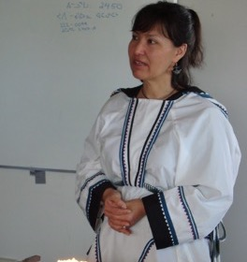
Who am I? What do I bring to my business?
Personal:
Confidence
Culture
Motivation
Spirituality
Self-awareness
Creativity
Goal Setting
Notes:
Say to Group: Explain that internal resources means qualities, character traits or strengths they have inside of them (not skills like sewing or cooking or teaching - that is in another section: Knowledge). Tell them it is important to remember who they are.
Activity:
Explore with participants how each of these listed items is important and helps running a business.
Explore some further examples of inner qualities they might bring and how that would help their business (If it helps, have them write down things that others (best friend, mother or colleague) might say about them). Some examples might include: quick learner, patient, lots of drive, never give up, quick with technology, strong, good writer or story-teller, very organized, humble in terms of knowing what don’t know and need to learn, strong faith in positive future.
Finally, have participants map here on paper all the internal strengths and resources they have that can help them with their business.

Slide 9
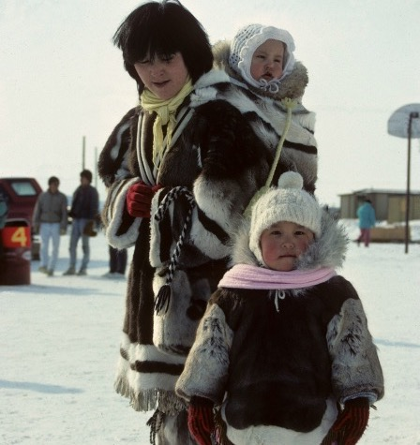
What are my networks and social support?
Social:
Support from family
Support from friends
Work/life balance
Community involvement
Political participation
Notes:
Say to Group: there is a richness of community in Northern culture that is important to draw from, and also expand upon. Sometimes we need to think outside just our family and friend circles for our business: to consider joining other local community or online groups that can help us learn and more widely share about our business, and be more comfortable talking about or business in a way that we don’t feel is boasting, but rather sharing an important dream to us.

Slide 10
Social Resources – Map it!
This is your Network, the relationships you have with others.
This can help you with:
Moral support and confidence you’re on the right track
Mentoring
Creative ideas
New learning and information
Hands-on help
Notes:
Say to Group: for your business to grow, your knowledge and understanding of all things connected, and speaking about it to others, must also grow. In addition to the need to learn and share around your business, the support you need will grow, sometimes support in different areas. Maybe you needed support first in getting your business registered and set up. Later, you start to expand and now need to know more about how to reach a wider market. Where do you get that knowledge and support from? What about when things get daunting or overwhelming?
Certainly some things you can get from google searches and online sources, but not everything, especially not: a. real first hand stories and experience from someone who is from or doing business in the North, and b. that late night call to someone close when you’re stressed and need a pep talk. c. someone to take your kids on the land for the day so you can get some much needed rest.
So much comes from the social circles around you.
You will always need to keep expanding the relationships and networks of people.
Activity: Map: who are the people/what are the social resources you are able to draw on right now, and who might you need to draw on in the future? Example from north?

Slide 11

How do I manage my money?
Financial:
Investment Money
Banking
Bookkeeping
Budgets
Notes:
Say to Group: there are many different parts to the financial part of a business: 1. a sum of investment money to get it started or to invest in any bigger items (like equipment or larger expenses like a marketer); and skills and tools needed for 2. setting up the right banking: accounts, etc; 3. setting up a proper bookkeeping system to track your daily and monthly revenues (income), expenses and profits for yourself and for tax purposes; 4. knowing how to lay out budgets and project future financial needs.
Move to next slide for Activity

Slide 12

Map it Activity
Activity:
Which of the 4 main areas of financial resources do you feel you are most comfortable with or are set up with already?
MAP IT OUT
Notes:
Say to Group: because there are many different financial parts to a business, it’s important to jump right in as soon as you can and learn them as best you can, with help if needed. It can be a lot of work, but the more you practice, like with a sport or cooking or sewing, the more you get used to it and the better you get.
Activity Part 2: Continue on after you’ve mapped what resources you do have, by discussing or noting down where you might get help with the areas that you are less comfortable with/less experience in, or need tools for, etc.

Slide 13

What do I know?
Knowledge:
Education
Skills
Traditional
Experience
Notes:
Say to Group: this is your personal resource that is most unique to you, and to your business. It’s a wonderful thing to be able to express all of yourself through your business idea and share your skills and passion with the community!

Slide 14
Knowledge…Map it.
Activity:
What specific knowledge of your craft or service or industry do you have that you bring to make your business successful?
What is missing and where to get it?
Notes:
Say to Group: Mapping out the knowledge you already have helps you to feel confident, as well as see clearly what other knowledge and skills you will still need to run your business (that you will then get through research, classes, a mentor, etc.). Of course, there may be knowledge you don’t realize you still need - that discovery comes as you move along with you business. This is a place to start your confidence-building, and your thinking towards a plan to build your knowledge.
Activity:
1.have participants map out all of the experience, skills, traditional and other knowledge and education that they (can) bring to their particular business. 2.Then write out or share what they think they still might need (there may be things of course they don’t realize they still need - that comes as they move along with their business).
3.Then have them explore how, or where they might go to get the knowledge that is missing.
Share if time.

Slide 15
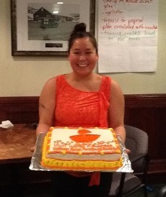
Wrap up…
Share something that stood out for you, that you learned from this workshop, or that you would like to share with the group before leaving.
Is there something you are excited to start doing?

Slide 16

Okpik Consulting
okpikconsulting.ca
Canadian Indigenous Business Development Resources
www.aadnc-aandc.gc.ca/eng/
1100100032796/1100100032800
RESOURCES
© Credit: Ilkka Koivula

Slide 17
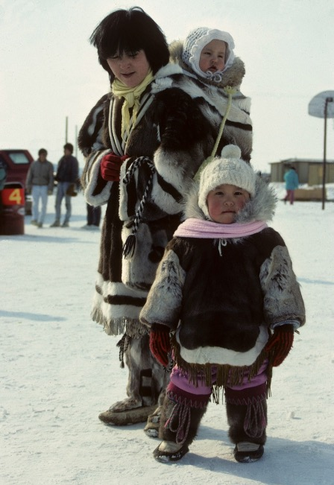


QUJANNAMIIK
THANK YOU!
Inspiring Entrepreneurship
for Stronger Inuit Communities

