Slide 1
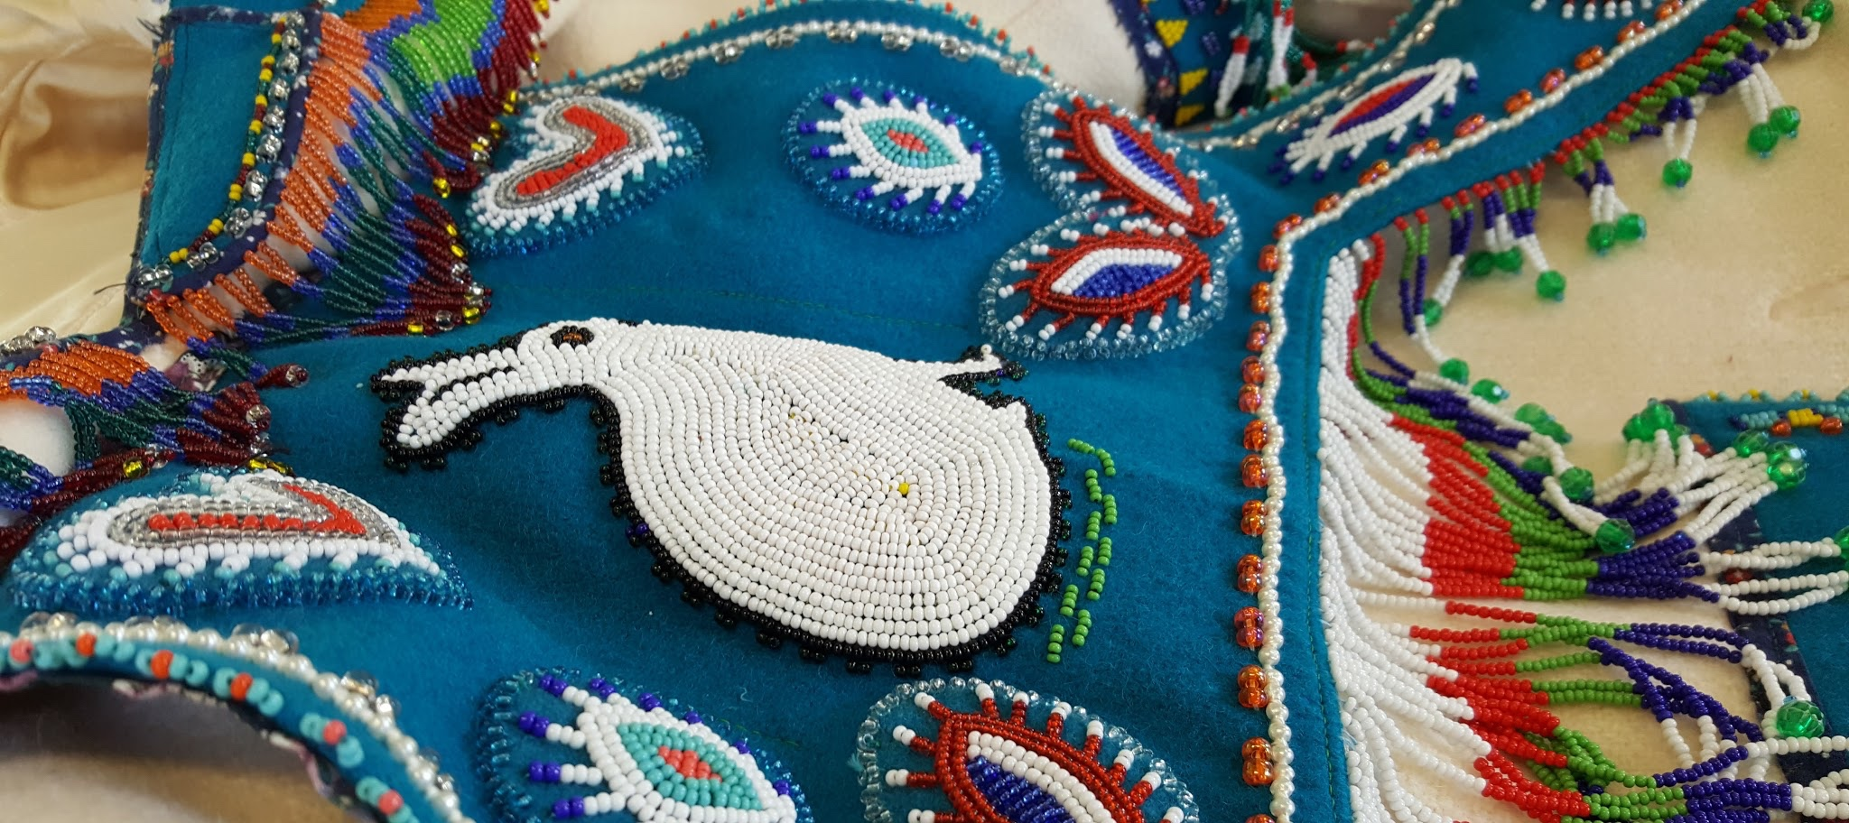



Slide 2
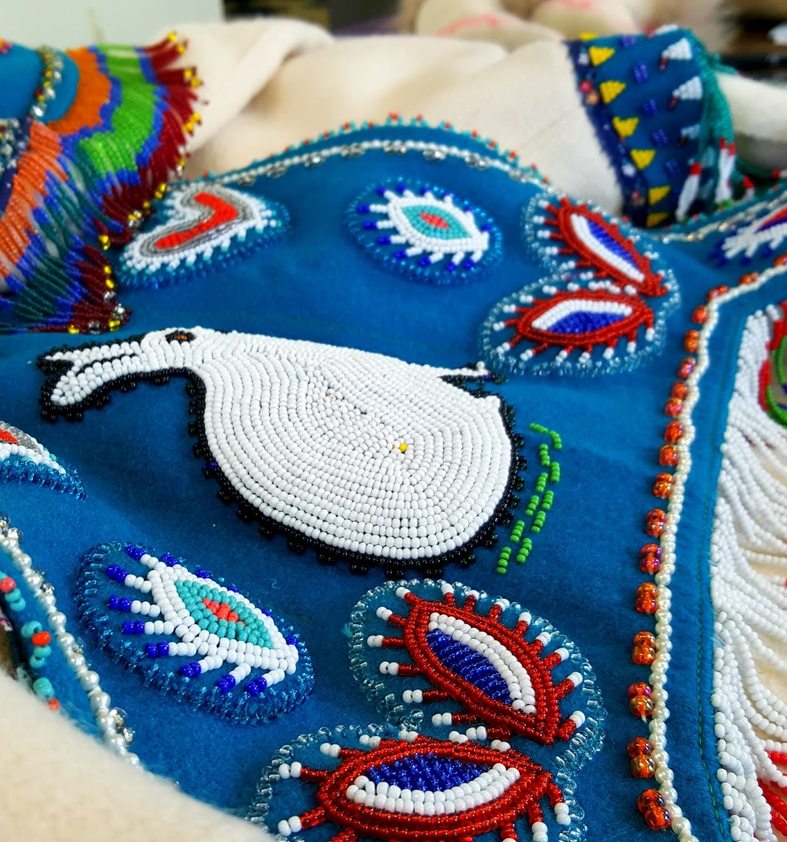
Meeting Agenda
The meeting agenda lays out the activities and timelines for your meeting.
PRESENTATION
CLICK TO BEGIN

Slide 3
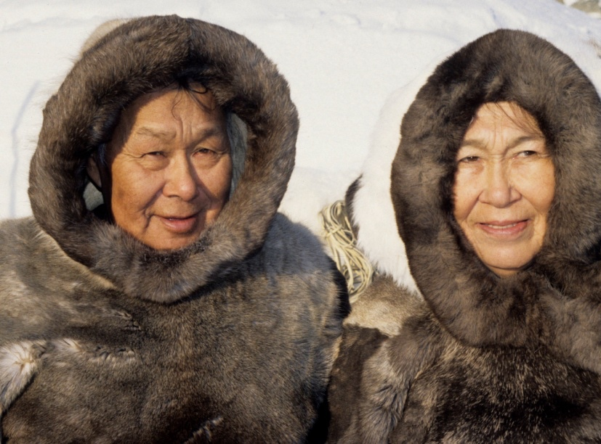
Welcome
and Review
The leading group member introduces the meeting and welcomes everyone. A review of the previous meeting is done along with a short discussion about any follow-up questions that were asked or additions that were made to the previous meeting’s conversation.

Slide 4
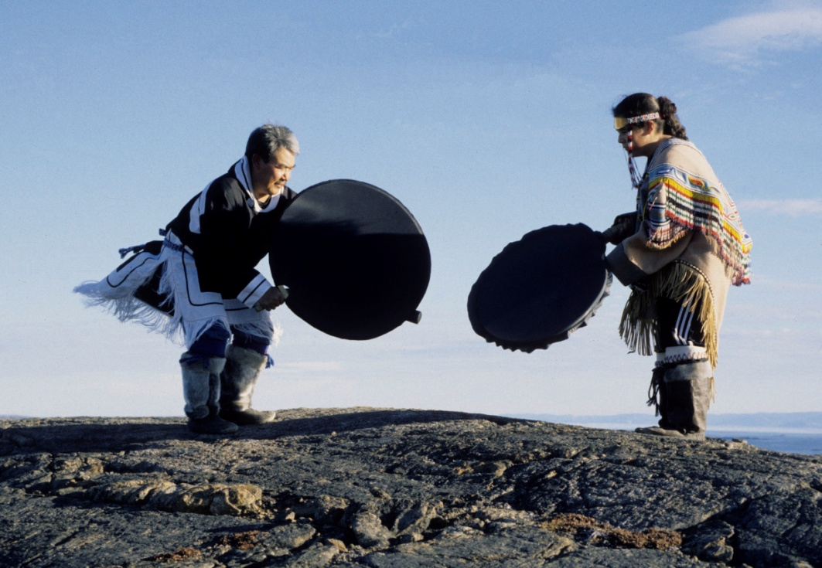
Ice Breaker
These exercises help relax everyone and helps build trust. They should be fun but also tie to team building, decision-making, etc.

Slide 5


CHALLENGES
DESCRIBING BUSINESSES
CHALLENGES
Group members take turns sharing their business successes and challenges with the group. After each person speaks, the group is given five minutes to respond and provide feedback to the person directly.
Some basic questions to start the discussion are:
Full name
Name of business and what it does
Something positive that has happened since the last meeting (business related or personal)
A challenge encountered since the last meeting (business related or personal)
After five minutes of group discussion, the group moves onto the next person. This continues until every person has spoken and received feedback.
COLLECTIVE FEEDBACK
SUCCESSES

Slide 6
UPDATES AND GROUP DISCUSSION
After the individual discussions, there is a broader open group discussion. The topics covered can be flexible and focus on what the members want to discuss. Some suggestions are:
Updates on a business support program
Upcoming meetings that may be of interest
Discussion on an issue of interest – tax preparation, software for business accounting and bookkeeping, business licensing, etc.
Sharing stories about business experiences, role models, case studies, etc.
Suggestions for future discussion by the group

Slide 7

www.pauktuutit.ca

