Slide 2
Business Checklist
A business checklist guides you through the various steps required to start and build a business. A checklist helps you plan ahead so you don’t forget any steps!
PRESENTATION
CLICK TO BEGIN

Slide 3
CHOOSE A BUSINESS IDEA

Slide 4
LOOK AT YOURSELF
Am I organized?
Do I have time to be a businesswoman?
Look at yourself: Do you have what it takes to be a good business person?
Talk to an experienced business person or your economic development officer.

Slide 5
WHO ARE YOU SELLING TO?
Other?
In order to build a successful business you have to know your customers. Think about who is most likely to buy your product or service. This information can help you write your business plan, your marketing and more.
Here are some questions to consider as a starting point. As you get to know who your average customer is, you might have more specific questions you want to know about your customers.
Married or single? Children?
Age?
Location?
Gender?
Average income?
Gender?

Slide 6
BUILD A SUPPORT NETWORK
Build a support network. Contact organizations such as economic development offices and regional chambers of commerce.
Check pauktuutit.ca/iwbn/support/who-can-help/ for more.

Slide 7
WRITE A BUSINESS PLAN
There are many actors that can help in the writing and development of a business plan, some are even region specific: Government of Nunavut, Inuvialuit Regional Corporation’s Economic Development Organization, Kativik Regional Government’s Business Development department and Nunatsiavut’s Business Centre.
More broadly, Canada Business Network also provides sample business plans and templates to help with the development of business plans.

Slide 8
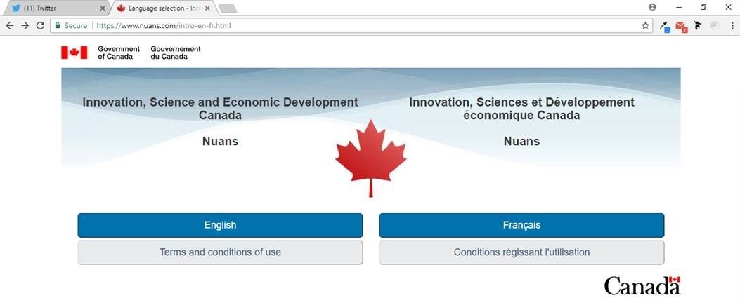
DECIDE ON A BUSINESS NAME
You can check NUaNS (http://www.nuans.com/nuansinfo_en/home-accueil_en.cgi) to see if someone else in Canada is already using your name.

Slide 9
FINANCING YOUR BUSINESS
Funding from a business service organization.
Loan from a bank, regional governments, the province/territory, etc.

Slide 10
APPLY FOR A BUSINESS LICENSE
A business license is required to legally operate a business. Licenses are issued and administered by different levels of government, including regional hamlets.

Slide 11
SPECIAL PERMITS AND LICENSES
Depending on what your business is, you might need to apply for special permits and licenses. This includes needing a license/permit for serving alcohol, specialized personal care services, baked good stores, etc. Canada Business Network is a good resource to check whether your business needs a special permit or license.
https://canadabusiness.ca/government/permits-and-licences/

Slide 12
OBTAINING A BUSINESS NUMBER
Register with the Canada Revenue Agency to get a business number.
Find the registration form at http://www.cra-arc.gc.ca/e/pbg/tf/rc1/rc1-12e.pdf.
Your business number is needed to register for GST, payroll or corporate income tax.
Business Registration Online helps you register for your business number, GST and payroll at www.cra-arc.gc.ca/tx/bsnss/tpcs/bn-ne/bro-ide/menu-eng.html.

Slide 13
CHOOSE A BUSINESS LOCATION
Decide where you will run your business (in your home or find a space). Check to make sure that you are permitted to run a home-based business (e.g. housing policies).

Slide 14
ZONING AND SAFETY REGULATIONS
Check with the hamlet to make sure you meet all zoning and fire safety regulations.

Slide 15
HIRING HELP
Decide if you need to hire any help.
You must take certain payments from your staff and send it to the Canada Revenue agency for Canada Pension Plan (CPP) contributions, Employment Insurance (EI) premiums and income tax on their pay. You must also match the CPP and EI payments collected.
For more information talk to an accountant or check: http://www.cra-arc.gc.ca/tx/bsnss/tpcs/pyrll/ hwpyrllwrks/menu-eng.html.

Slide 16
REGISTERING FOR COMPENSATION
Register with the Workers’ Safety and Compensation Commission (WSCC) to help provide compensation if someone in your business gets injured on the job and make sure you meet your responsibilities as an employer
http://www.wcb.nt.ca/Pages/default.aspx

Slide 17
STAY ORGANIZED
Stay organized and on top of your business.

Slide 18
www.pauktuutit.ca

