Slide 1
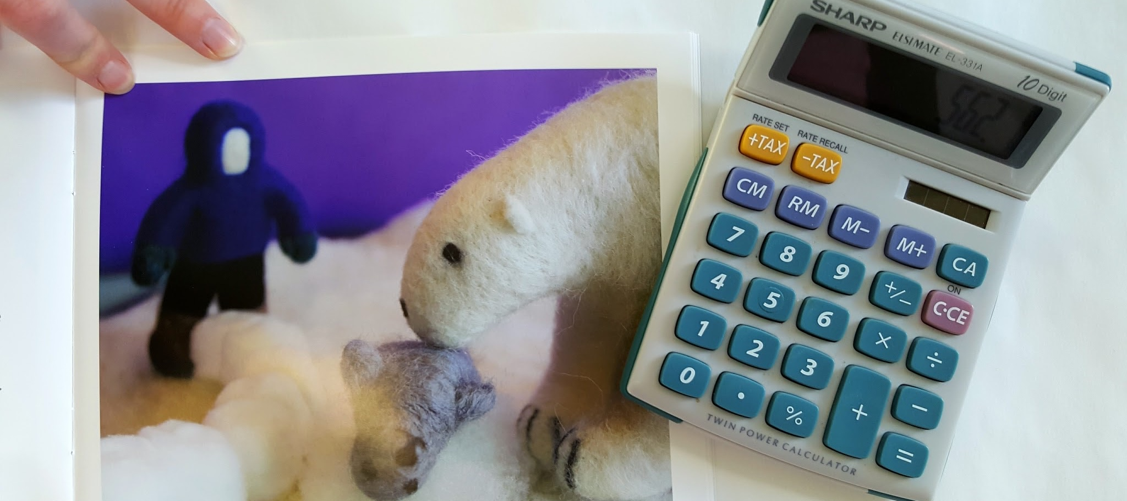

Slide 2
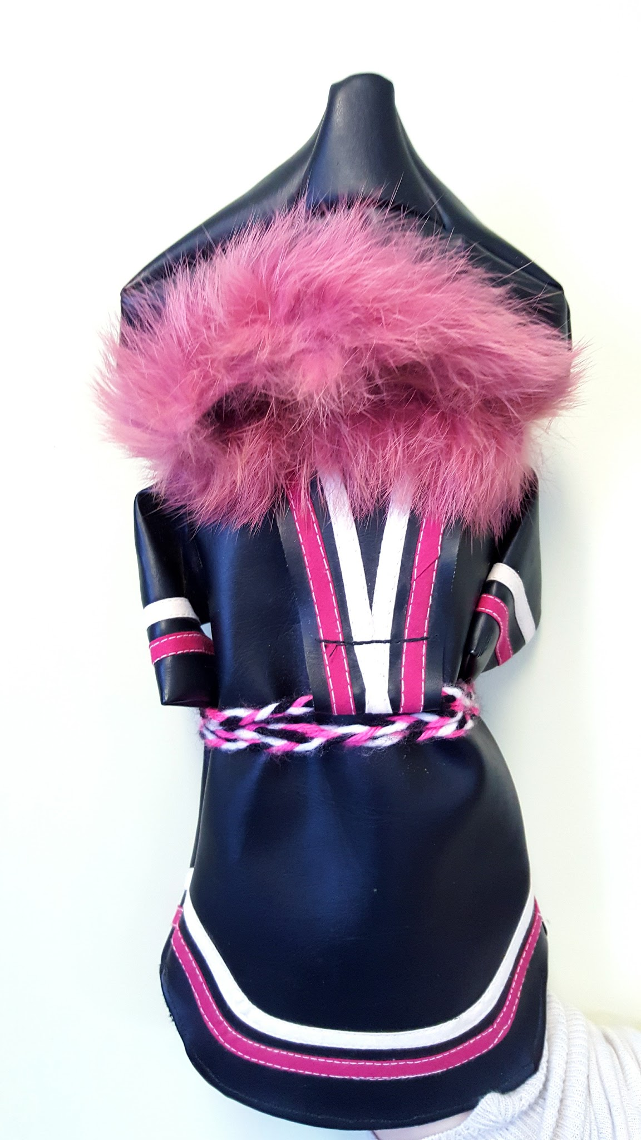
Business Tips
Here are some insights provided by other Inuit businesswomen on starting or expanding a business.
PRESENTATION
CLICK TO BEGIN

Slide 3
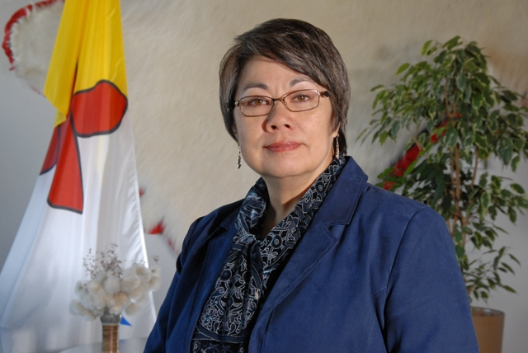
The Honourable Eva Aariak (former Premier of Nunavut), who had her own business until she was elected Premier.
“For anyone thinking about starting a business, don’t be afraid to take a risk! Loving what you do is important, but taking good care of the financial management and administrative side of your business is the key to its success. Also, nurture a support network in your community, and it will nurture you right back!”

Slide 4
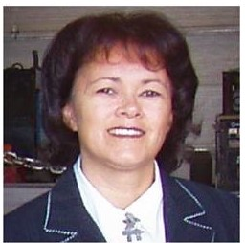
Hilda Broomfield-Letemplier, owner of Pressure Pipe Steel Fabrication Ltd. (Happy Valley-Goose Bay, NL)
“Develop a hunger for learning – learning is a lifelong process. This isn’t just a saying; it is an important attitude to have in business. The world changes quickly and to be successful you have to understand these changes and be prepared to adapt your business to meet needed opportunities.”

Slide 5
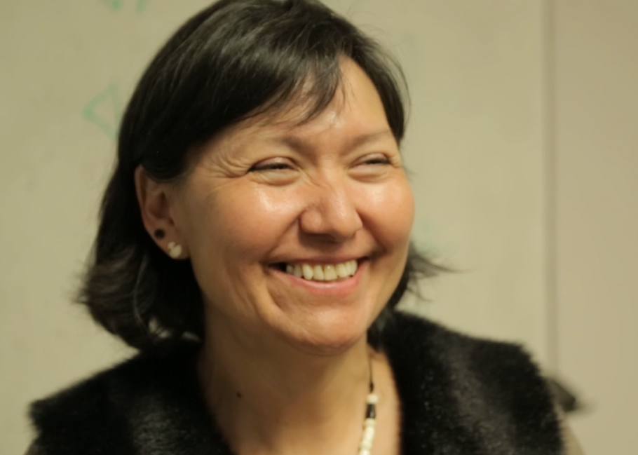
Leena Evic, owner of the Pirurvik Center (Iqaluit, NU)
“Maintaining a balance in your life is critical to success in all ways. You need to take care of yourself physically, mentally and spiritually.”

Slide 6
www.pauktuutit.ca

